Slide 1

Data-Powered Decisions
A Comprehensive EDA for Business Optimization at Global Electronics

Slide 2
Agenda
Problem Statement
About the company
Data Analysis – The Why?
Tools and Technologies
Project Modules
Power BI –Dashboard
Analytical & Statistical Visualizations
Future Enhancement
Conclusion

Slide 3
About the company
Global Electronics is a company operating in the electronics industry, involved in manufacturing, retailing, or distributing consumer electronics, components, or related products.

Slide 4
Problem Statement
Global Electronics is looking forward to analyze the data effectively to infer the best, moderate and low sales of their company.
Their objective is to develop their sales positively and render enhanced customer services across the globe.
The project is developed to provide solution to the company producing a full fledged report which has all the answers to where and how to excel their business globally.

Slide 5
Data analysis on the data – The Why?
Data analysis enables them to outperform competitors by being more agile, understanding market needs better, and offering superior products and services.
Enhance Customer Satisfaction
Optimize Operations
Inventory management
Performance insights
Drive Business Growth
Decision-Making Support
Competitive Advantage

Slide 6
Power Bi
Ron George developed Power BI and Microsoft officially launched it in 2013, and it is now a leading business intelligence tool worldwide.
Power BI is a data analytics and visualization tool. It helps users connect to various data sources, transform raw data, and create interactive dashboards and reports to support data-driven decisions.
.

Slide 7
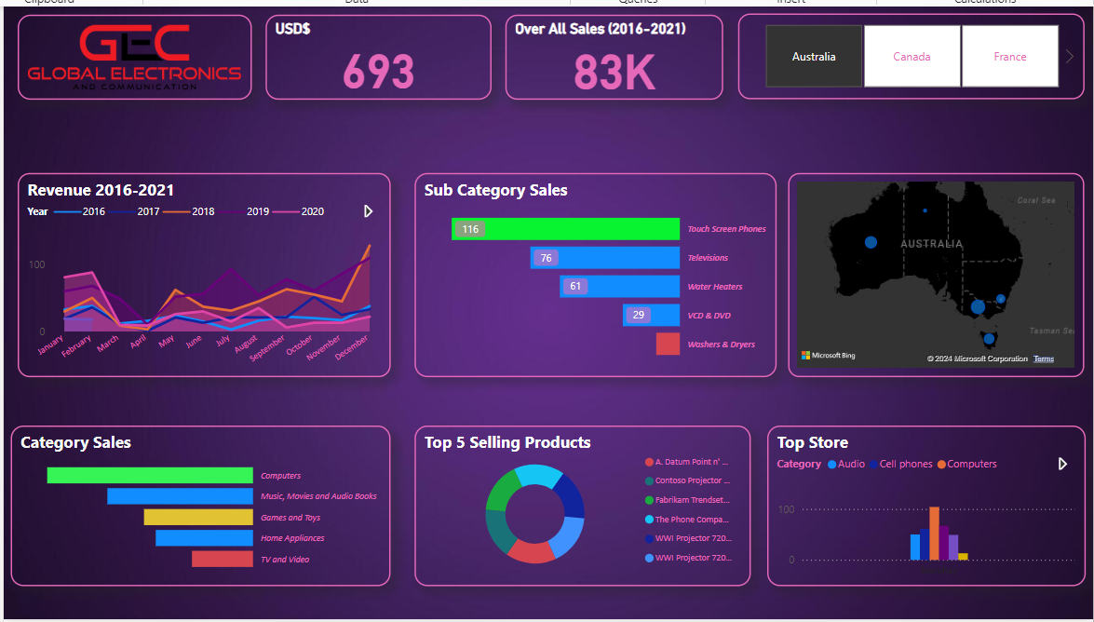
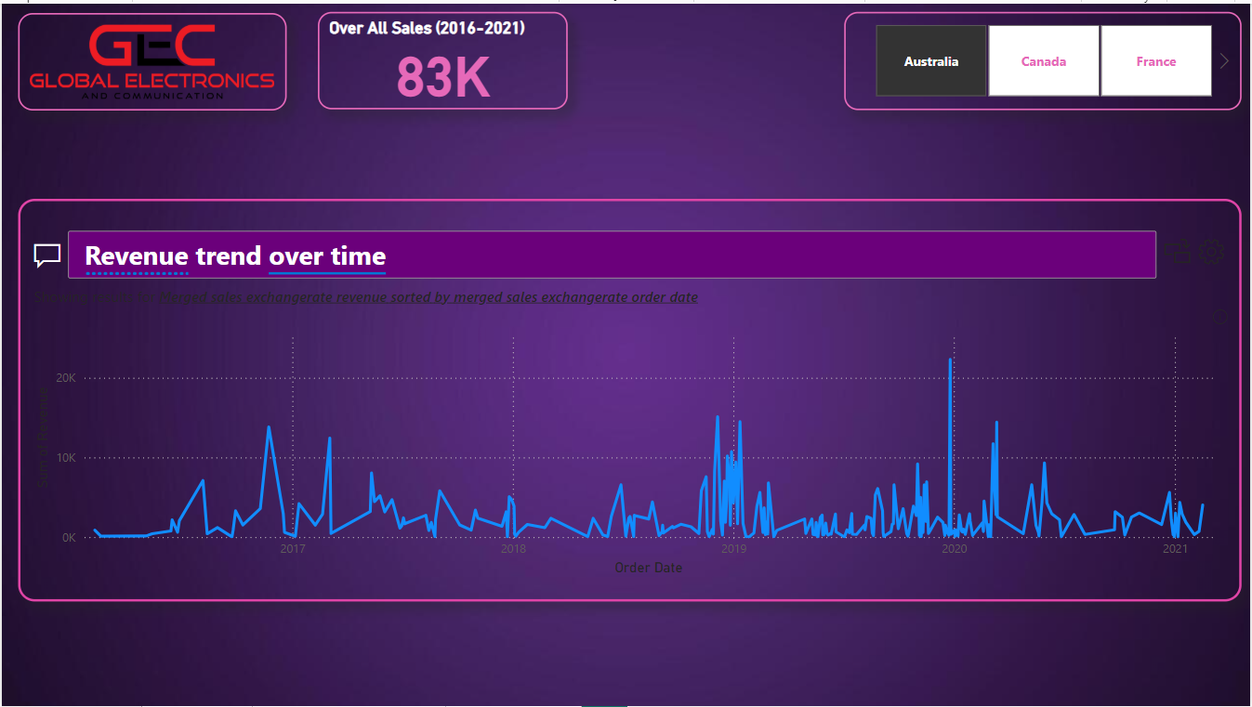
DPD of Global Electronics - Dashboard
Visualization using various DAX
Dynamic Generation using NLP

Slide 8
EDA – Matplotlib & Scipy
Pandas, data were read and written from and into csv files
Scipy , the statistical nature of the data distributions was studied and handled. Sales over month using skewness, correlation etc., were found.
Matplotlib, plot, histogram, bar, count plot, heatmap, etc., were performed for various insights.
.

Slide 9
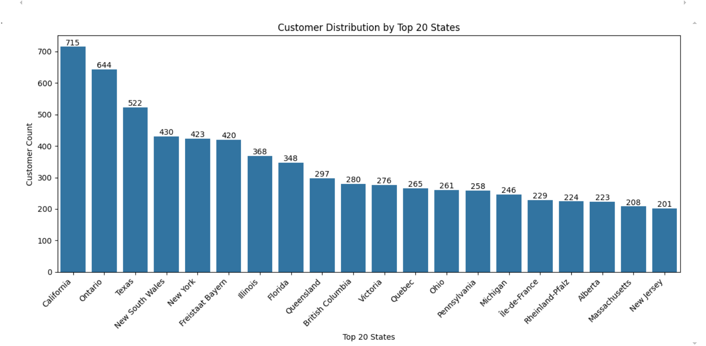
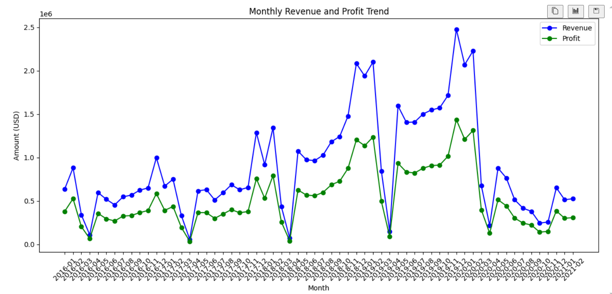
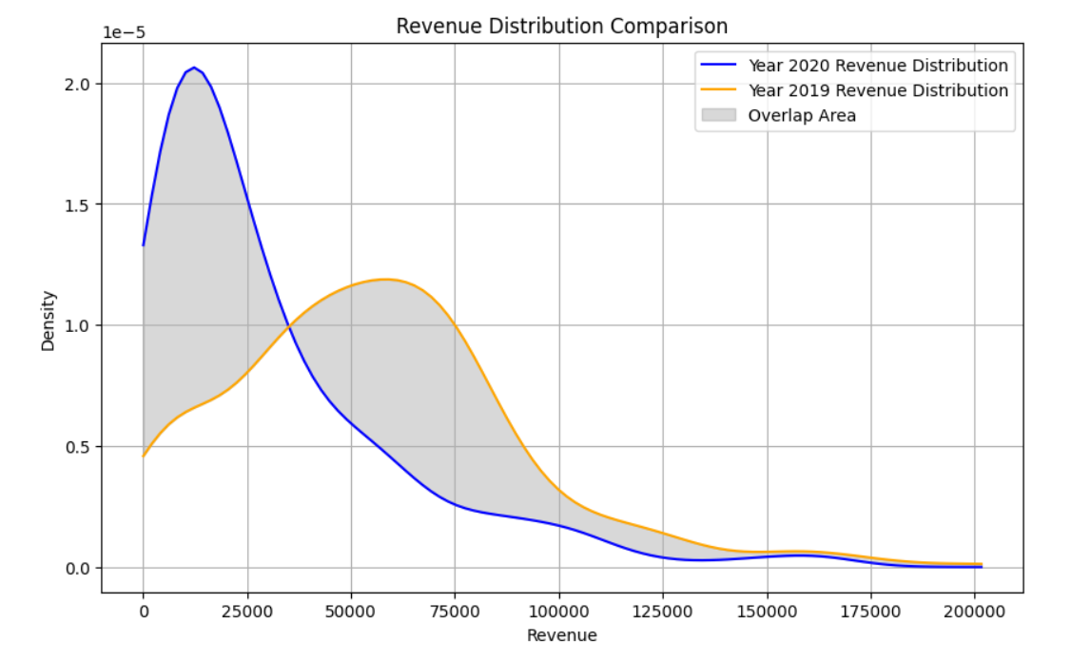
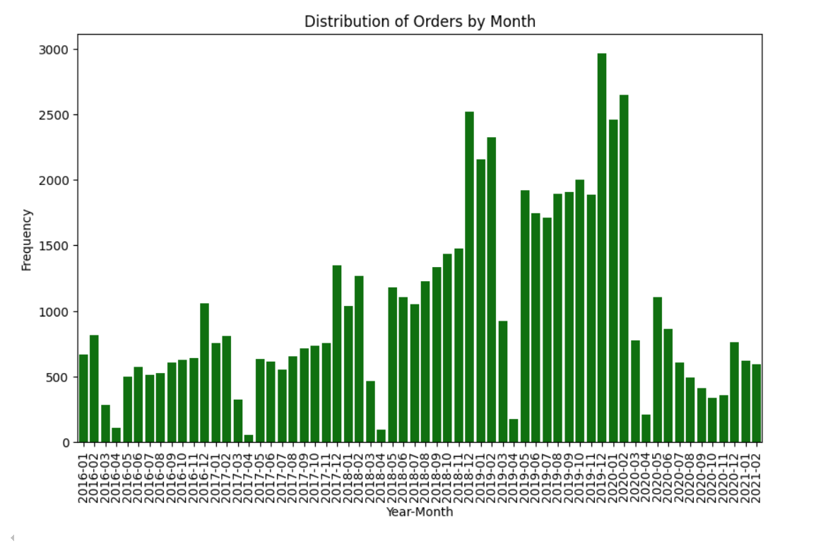
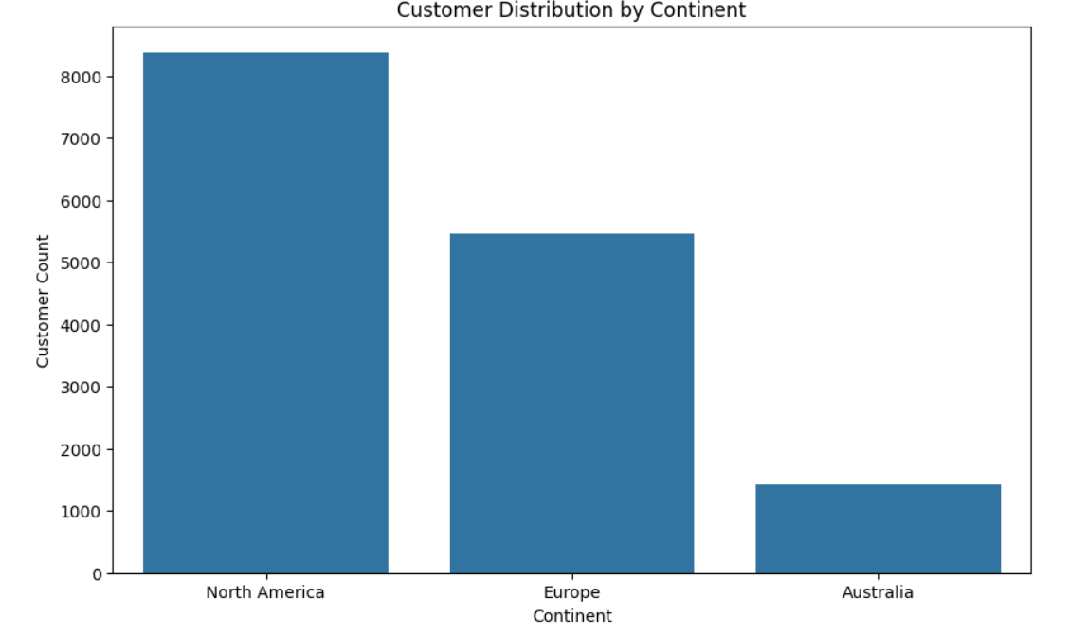
Statistical Data Visualizations

Slide 10
Project Modules
Module 1: Exploratory Data Analysis & Statistical Visualizations
Data preprocessing/cleaning/handling
Visualization using matplotlib
Distribution Analysis
Module 2 : Data Schema Creation
MySQL Database and tables with relationship established.
Module 3 : Power BI for Dashboard
Preparing Data, establishing relationship and Query Selection using DAX.
Dashboard using visualization tools and Natural Language Processing for Q&A.

Slide 11
Inferences/ Insights of DPD
Best performing Products, brands, category and sub category were found
Sales from 2016 to 2021 were seen in different granularities and filters
Customers orders, sales, revenue and profit on geographical sectors were portrayed
Best performing stores and brand in particular countries were captured
o dynamically calculate all the above metrics based on Country in Power BI were performed using, DAX query and slicers
Highest and lowest performing products based on time intervals were hierarchically diagnosed.
NLP based Q&A.

Slide 12
Future of DPD
Incorporating Azure Synapse Analytics for scalable data storage, Azure Machine Learning for predictive sales insights, Azure Stream Analytics for real-time monitoring, Microsoft Dynamics 365 for unified CRM/ERP integration, and Power Automate for workflow automation. As a future enhancement, build a recommendation system using AI to suggest products or promotions based on customer purchasing patterns.

Slide 13
Conclusion
Data Powered Decision(DPD) project successfully integrated and analyzed sales, revenue, and profit data across multiple regions and currencies, providing valuable insights through interactive Power BI dashboards and Visualization and Scientific Libraries encompassing Matplotlib and SciPy.

